Slide 1
Performance Management
Be the Boss Everyone Wants to Work for or the Employee Every Boss Wants to Keep

Slide 2
MANAGER OR EMPLOYEE
Discard false narratives
Develop an effective performance management system
Set CLEAR goals, DEFINE expectations & provide feedback
Avoid work habits that annoy bosses
Replace bad habits with productive practices
Manage your own performance

Slide 3
False Narratives
Globalpost.com
Work ethic
  Honest
  Refrains from Gossip
  Values diversity
  Respects others
  Cooperative
  Do you agree?
  If not, what is on your List?

Slide 4
Exercise
What did cooperative or uncooperative look like?
What behaviors were exhibited?
What didn’t happen or wasn’t happening?
What was the “tipping point?”

Slide 5
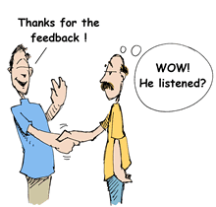
Specifics get best Results!

Slide 6

Labels can Stick
Disorganized

Slide 7
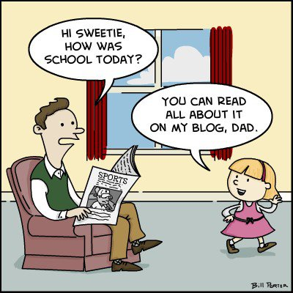
Generational differences

Slide 8

It Begins with Awareness

Slide 9
Performance management system

Slide 10
Development systems you can deploy (about money)
Develop yourself first
Develop an atmosphere of trust
Turn meetings into learning opportunities
Ask questions
Delegate
Give stretch assignments
Help employees navigate politics and the culture

Slide 12
Challenge
Think of a common situation which occurs in your workplace. What’s the big versus the little picture?

Slide 13

Work Order Game

Slide 14

Six Habits that annoy bosses
Procrastination
Negative thinking
Dishonesty
Lateness
Gossiping
Resisting change

Slide 15
Better Habits
Act immediately on phone messages.
Prepare for tomorrow until today.
Don’t sit at a desk all day.
Organize your tasks.
Stand up when you take phone calls.
Stick to a schedule.
Learn to say no.
Don’t let email take over your day.
Stay off of social media while at work.
Use technology.

Slide 16
Manage own performance
Identify your strengths
Use your strengths to perform
Develop good management skills to help you perform at your best
Create more discretionary time (time which you control)
Find energy sources and use that energy to be re-charged, refreshed and creative
Focus on delivering meaningful outcomes
Get the right work-life balance

Slide 17


